Slide 1
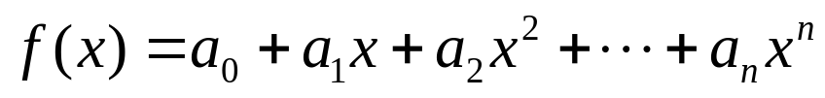
Interpolation
Chapter 18
Estimation of intermediate values between precise data points. The most common method is:
Although there is one and only one nth-order polynomial that fits n+1 points, there are a variety of mathematical formats in which this polynomial can be expressed:
  The Newton polynomial
  The Lagrange polynomial

Slide 2
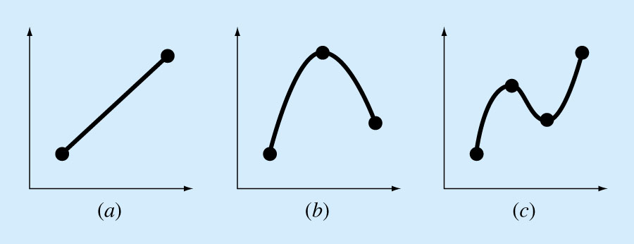
Figure 18.1
Chapter 18

Slide 3
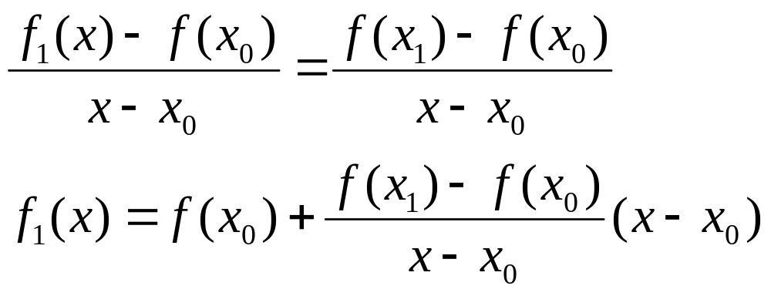
Newton’s Divided-Difference Interpolating Polynomials
Linear Interpolation/
Is the simplest form of interpolation, connecting two data points with a straight line.
f₁(x) designates that this is a first-order interpolating polynomial.
Slope and a finite divided difference approximation to 1st derivative
Linear-interpolation formula
Chapter 18

Slide 4
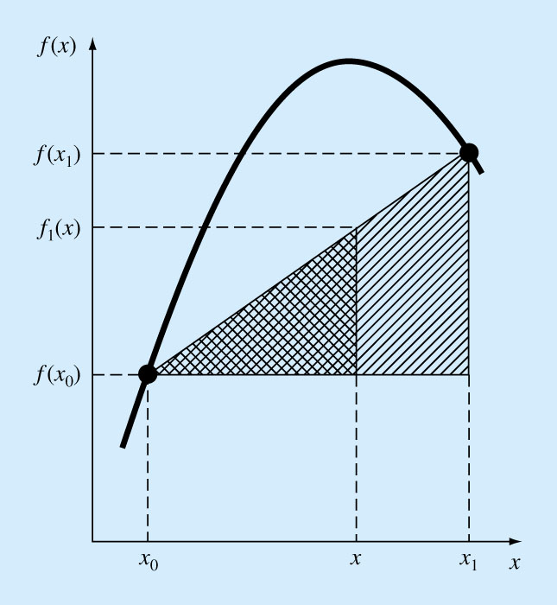
Figure
18.2
Chapter 18

Slide 5
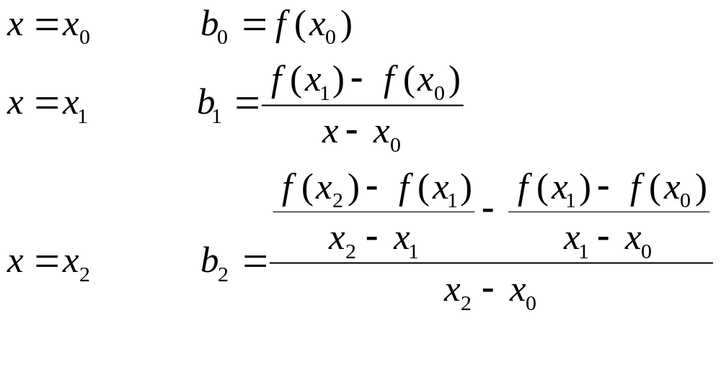
Quadratic Interpolation/
If three data points are available, the estimate is improved by introducing some curvature into the line connecting the points.
A simple procedure can be used to determine the values of the coefficients.

Slide 6
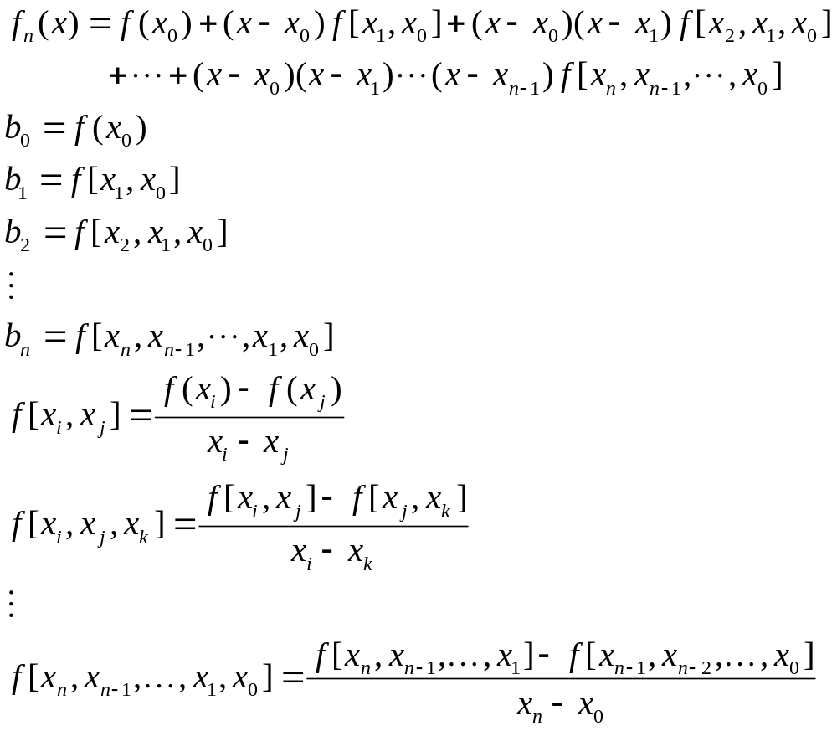
General Form of Newton’s Interpolating Polynomials/
Bracketed function evaluations are finite divided differences
Chapter 18

Slide 7
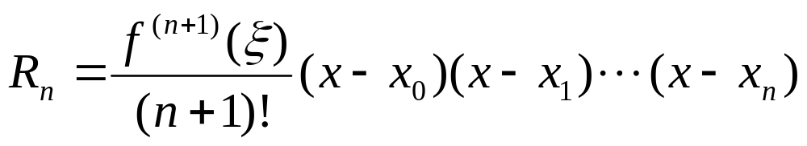
Errors of Newton’s Interpolating Polynomials/
Structure of interpolating polynomials is similar to the Taylor series expansion in the sense that finite divided differences are added sequentially to capture the higher order derivatives.
For an n^{th}-order interpolating polynomial, an analogous relationship for the error is:
For non differentiable functions, if an additional point f(x_{n+1}) is available, an alternative formula can be used that does not require prior knowledge of the function:
ξ Is somewhere containing the unknown and he data
Chapter 18

Slide 8
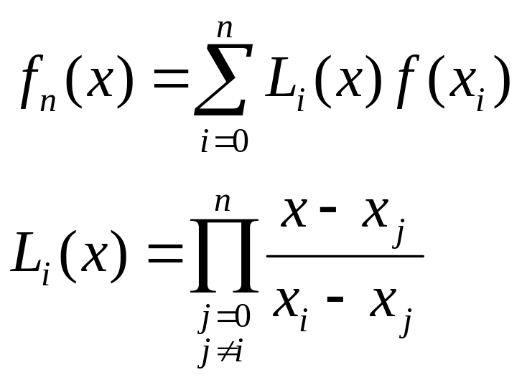
Lagrange Interpolating Polynomials
The Lagrange interpolating polynomial is simply a reformulation of the Newton’s polynomial that avoids the computation of divided differences:
Chapter 18

Slide 9
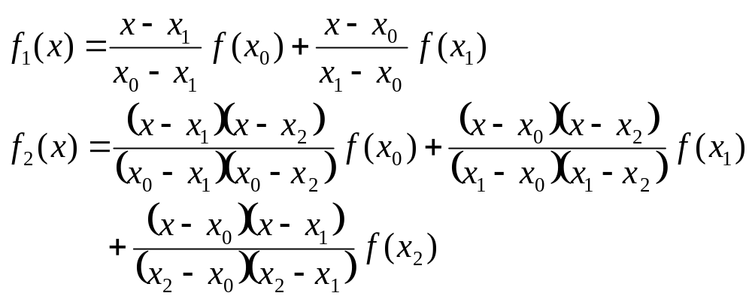
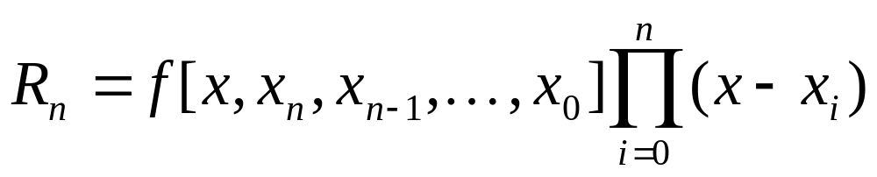
As with Newton’s method, the Lagrange version has an estimated error of:
Chapter 18

Slide 10
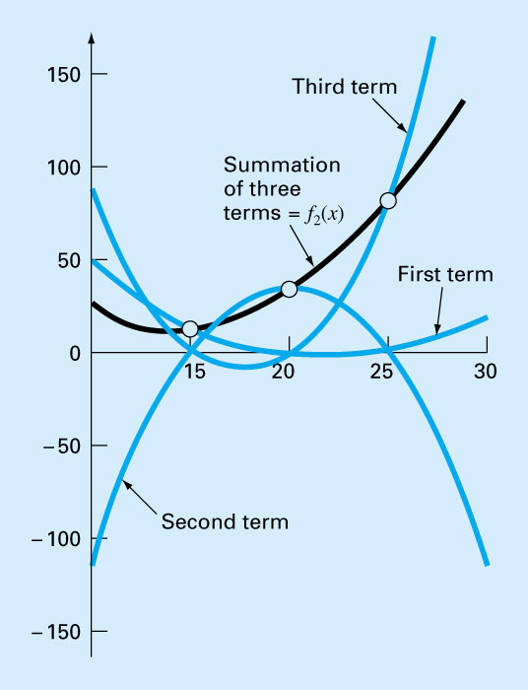
Figure 18.10
Chapter 18

Slide 11
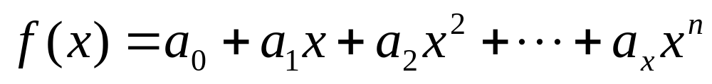
Coefficients of an Interpolating Polynomial
Although both the Newton and Lagrange polynomials are well suited for determining intermediate values between points, they do not provide a polynomial in conventional form:
Since n+1 data points are required to determine n+1 coefficients, simultaneous linear systems of equations can be used to calculate “a”s.
Chapter 18

Slide 12
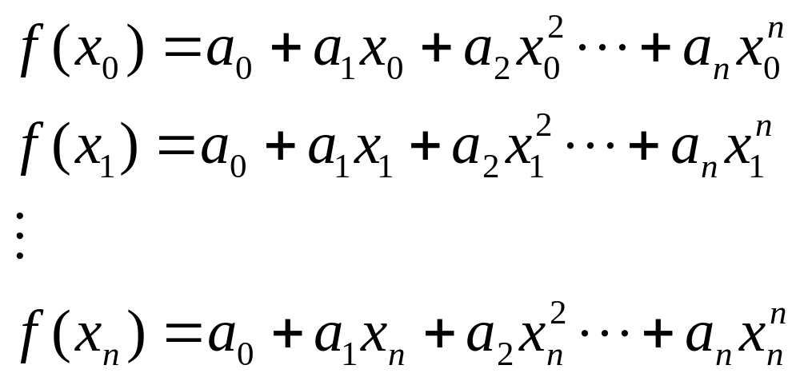
Where “x”s are the knowns and “a”s are the unknowns.
Chapter 18

Slide 13
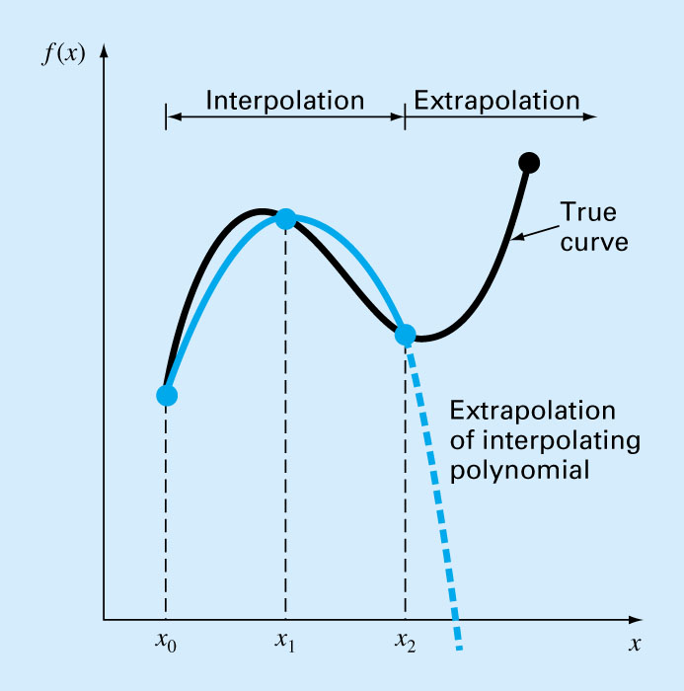
Figure 18.13
Chapter 18

Slide 14
Spline Interpolation
There are cases where polynomials can lead to erroneous results because of round off error and overshoot.
Alternative approach is to apply lower-order polynomials to subsets of data points. Such connecting polynomials are called spline functions.
Chapter 18

Slide 15
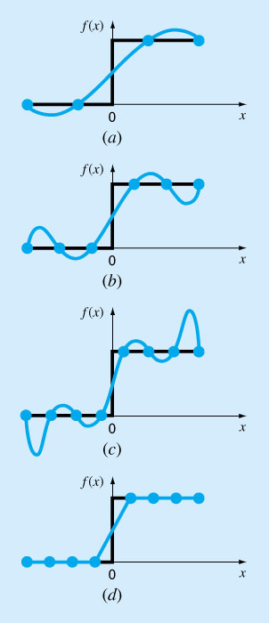
Figure 18.14
Chapter 18

Slide 16
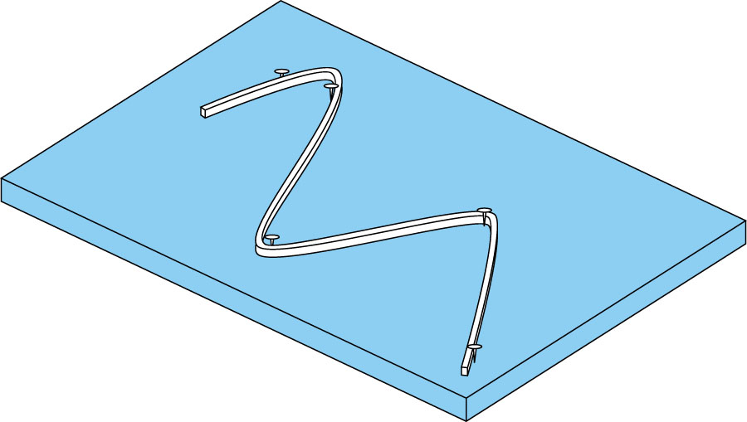
Figure 18.15
Chapter 18

Slide 17
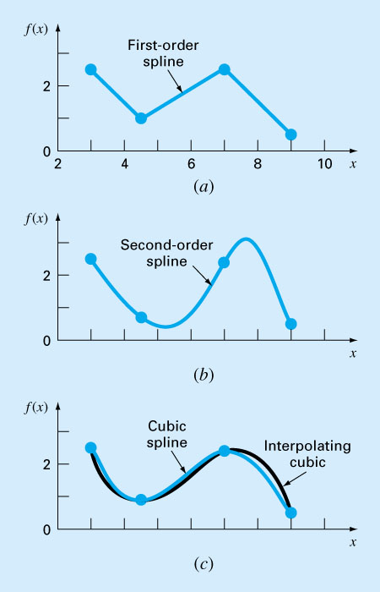
Figure 18.16
Chapter 18

Slide 18
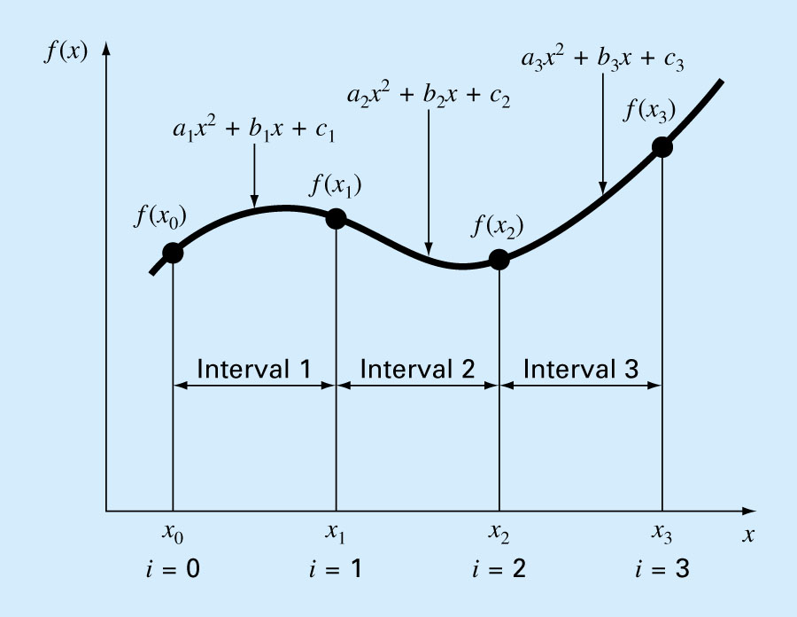
Figure 18.17
Chapter 18

